Slide 1
Netflix Data Analysis
Case Study

Slide 2
Objective
Netflix is a popular streaming service that offers a vast catalog of movies, TV shows, and original content. The purpose of this Netflix data analysis is to enhance Netflix’s Content Strategy by using data-driven insights. This will allow to
1
Optimize content offerings across countries and genres.
2
Good understanding on audience preferences and the patterns
3
Assist in making better decisions about which genres, countries and types of content to expand

Slide 3
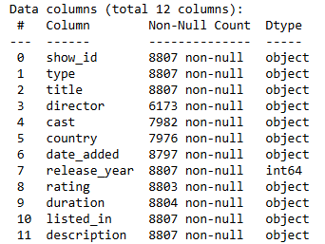
Netflix Dataset
The Netflix dataset from Kaggle contains information about movies and TV shows on the Netflix platform. Dataset Link: https://www.kaggle.com/datasets/shivamb/netflix-shows
Key info about the dataset
1
Content added to Netflix from 2008 to 2021
2
The number of row is 8807 with 12 columns
3
Data types of columns are shown.
4
Used Python to prepare and clean the dataset
5
Interactive reporting visuals created on the PowerBi tool

Slide 4
Purpose
The data analysis aims to understand the distribution of content types, popular genres, countries of origin and audience ratings. This will allow us to address key questions related to Netflix’s content distribution to uncover opportunities to enhance its competitive edge in the market.
Key areas to focus on are
1
Analyze data pattern over Netflix’s content type
2
Examine content distribution by country
3
Evaluating contributions of specific directors, actors or genres
4
Understanding the trends in genre diversity with duration

Slide 5

Data Cleansing
To prepare the dataset for visualisation, the following steps have been taken to clean the data
1
Handling manual errors
2
Handling null values and duplicate data
3
Cleaning column data value to have appropriate data type
4
Adding columns for later use
5
Changing data types
6
Creating a new subset of data
7
Python script to load data into PBI

Slide 6
Data Analysis
To understand trends and patterns following measures and KPIs used in visualisation
1
Count the number of Movies vs TV Shows
2
Find the most common rating for movies and TV shows
3
Identify understated genres on Netflix
4
Analyze country-wise contributions to Netflix’s library
5
I identify the most frequent directors, actors and genres
6
Find the average release year for content produced in a specific country
7
Identify the longest movie and TV show duration

Slide 7
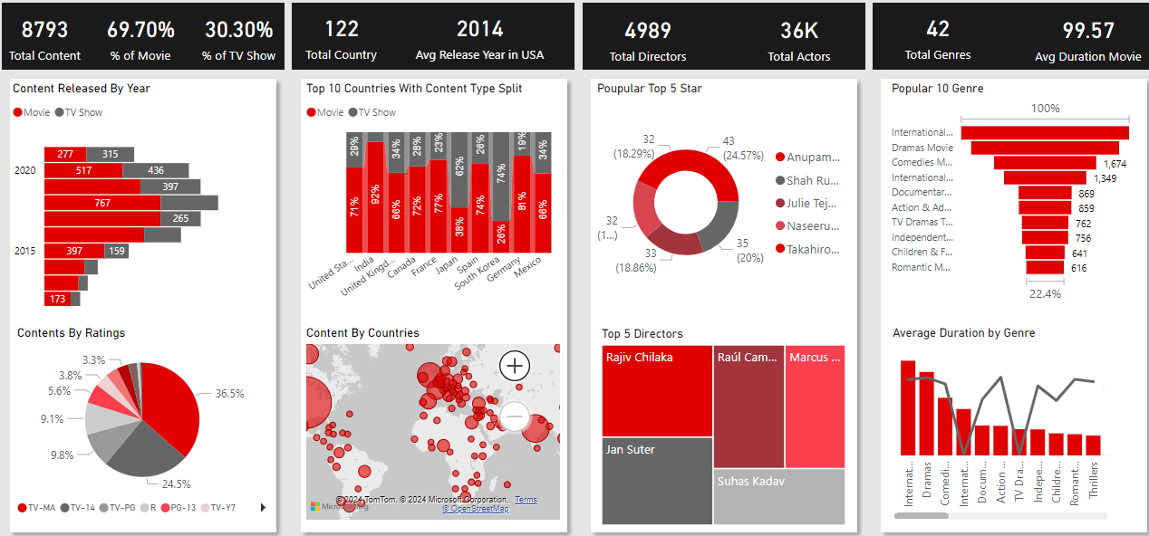
Dashboard Reporting
An interactive report indicates the key performance indicators over content types, distribution, and origin of countries, and a few visuals analyse the patterns and trends over different categorisations.
1
Content Analysis

Slide 8
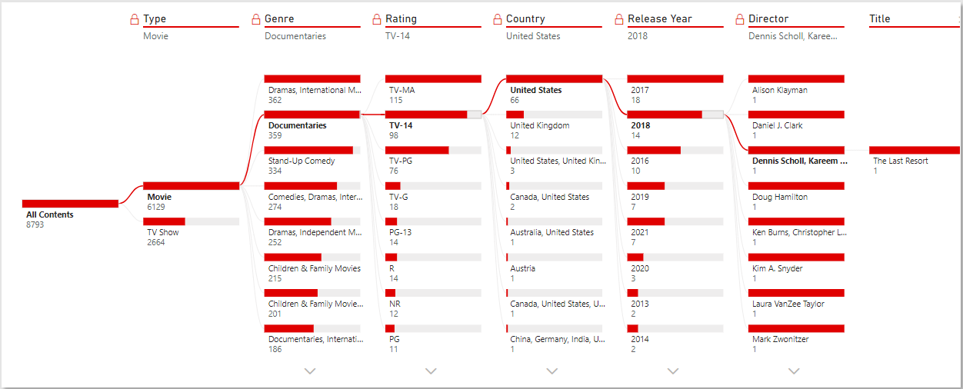
Dashboard Reporting
2
Search Content

Slide 9
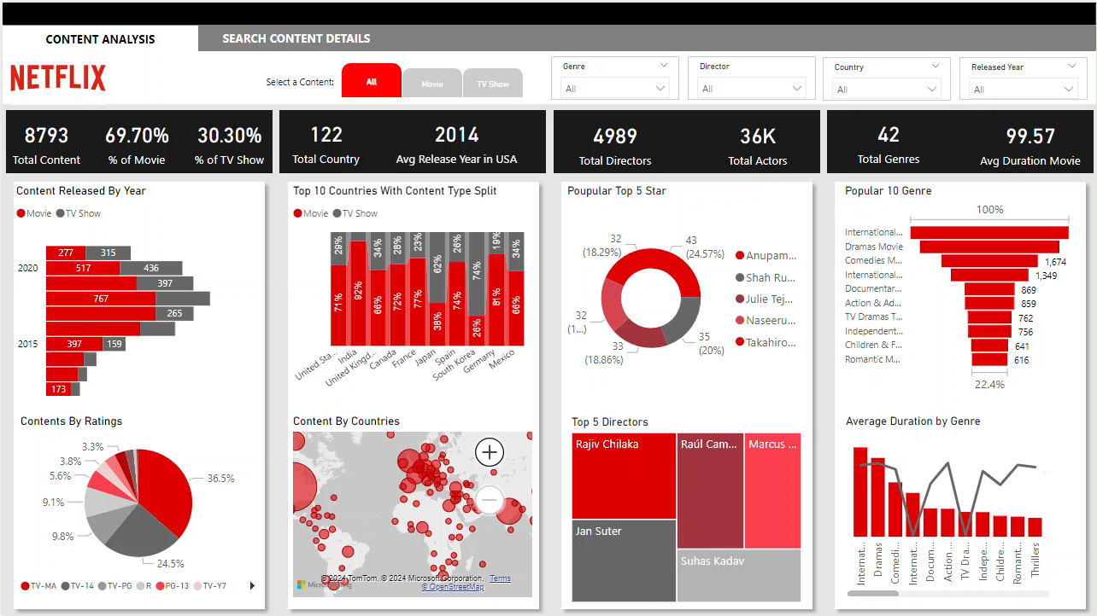
Dashboard Reporting
3
Menu Navigation

Slide 10
Conclusion
In conclusion, Netflix’s data analysis reveals key insights into user behaviour, content preferences, and operational trends that are essential for driving business decisions and enhancing user experience.
Followings are the key takeaways
1
Netflix has more Movies than TV shows
2
Most Movies & TV shows are produced in the United States, followed by India which has made the second number of movies on Netflix
3
2018 is the year in which Netflix released a lot more Content as compared to other years
4
International Movies, Dramas & Comedies are the most popular Genres on Netflix
5
Netflix’s movie duration is mostly between 80 to 120 minutes, and there is a drastic difference in preferred one season of TV shows.

Slide 11
END

